Slide 1
SIMF Concept Modeling Profile
SIMF
Jim Logan
Director of Semantic Technologies and Interoperability
No Magic

Slide 2
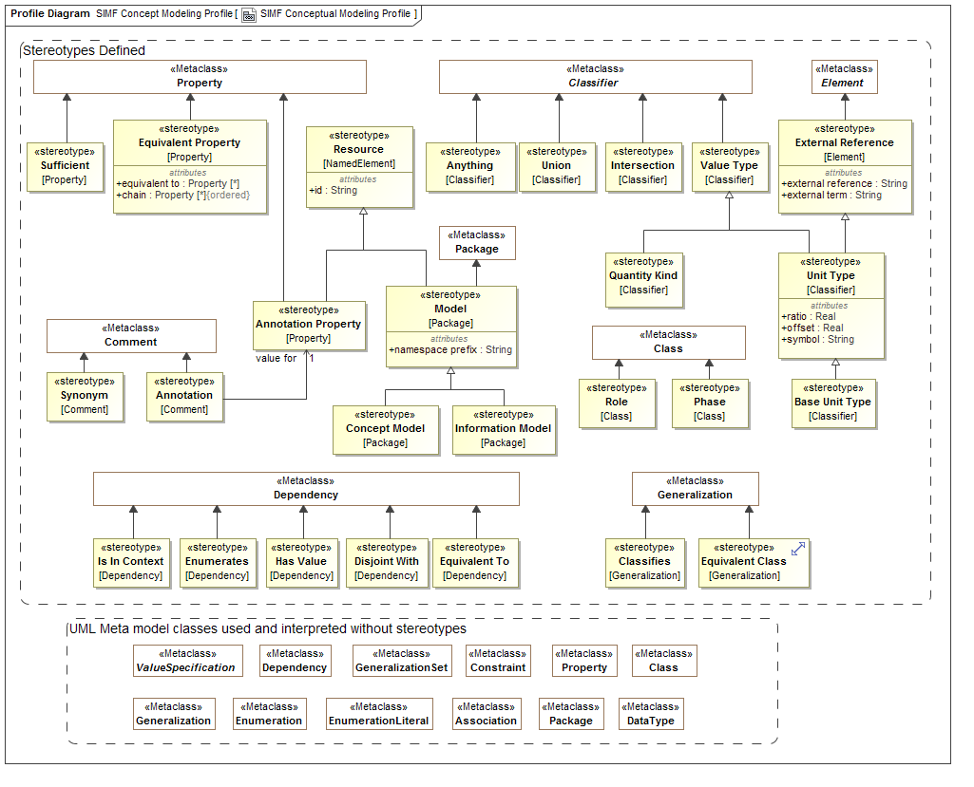
Profile

Slide 3
Overview
Uses “normal” UML with business-facing terms
Packages
Classes
Generalization / Generalization Set
Properties
Associations
Association Classes
Takes advantage of a few “loose” areas of UML
Unnamed redefining properties
Unnamed subsetting properties
Adds some extensions (next slide)

Slide 4
Extensions to UML
Class extensions:
«Anything»
«Union»
«Intersection»
«Equivalent Class»
«Role»
«Phase»
Comment extension: «Annotation» {annotation property = annotation property}
Property extensions:
«Annotation Property»
«Equivalent Property»
{equivalent property = property}
{chain = property, property}
«Sufficient»
«Value Type»
«Facet Of» (Examples still say «Classifies»)

Slide 5
Simple Classes and Properties (Model)

Slide 6
Simple Classes and Properties (MM Instances)

Slide 7
Simple Classes and Properties (OWL)
Ontology(<http://example.com/SIMF/Company>
Declaration(Class(:Employee))
Declaration(Class(:Employer))
Declaration(ObjectProperty(:employedBy))
Declaration(ObjectProperty(:employs))
SubClassOf(:Employee ObjectIntersectionOf(
ObjectMaxCardinality(1 :employedBy :Employer)
ObjectMinCardinality(1 :employedBy :Employer))
)
InverseObjectProperties(:employedBy :employs)
ObjectPropertyDomain(:employedBy :Employee)
ObjectPropertyRange(:employedBy :Employer)
ObjectPropertyDomain(:employs :Employer)
ObjectPropertyRange(:employs :Employee)
AnnotationAssertion(rdfs:label :Employee "Employee"@en)
AnnotationAssertion(rdfs:label :Employer "Employer"@en)
AnnotationAssertion(rdfs:label :employedBy "employed by"@en)
AnnotationAssertion(rdfs:label :employs "employs"@en)
)
Namespace prefixes elided for readability.
Will elide most annotations for remaining slides.

Slide 8
Global Properties (Model)

Slide 9
Global Properties (MM Instances)

Slide 10
Global Properties (OWL)
Ontology(<http://example.com/SIMF/Relations>
Import(<http://example.com/SIMF/DutiesAndResponsibilities#>)
Declaration(Class(<http://example.com/SIMF/DutiesAndResponsibilities#Duty>))
Declaration(ObjectProperty(:hasResponsibility))
Declaration(ObjectProperty(:isConferredBy))
Declaration(ObjectProperty(:isConferredOn))
ObjectPropertyRange(:hasResponsibility
<http://example.com/SIMF/DutiesAndResponsibilities#Duty>)
)

Slide 11
Incomplete and Overlapping Subclasses (Model)

Slide 12
Incomplete and Overlapping Subclasses (MM Instances)

Slide 13
Incomplete and Overlapping Subclasses (OWL)
Ontology(<http://example.com/SIMF/Manufacturer1>
Declaration(Class(:CarManufacturer))
Declaration(Class(:Manufacturer))
Declaration(Class(:WindshieldManufacturer))
SubClassOf(:CarManufacturer :Manufacturer)
SubClassOf(:WindshieldManufacturer :Manufacturer)
)

Slide 14
Incomplete and Disjoint Subclasses (Model)

Slide 15
Incomplete and Disjoint Subclasses (MM Instances)

Slide 16
Incomplete and Disjoint Subclasses (OWL)
Ontology(<http://example.com/ontology/Animals>
Declaration(Class(:Animal))
Declaration(Class(:Cat))
Declaration(Class(:Dog))
SubClassOf(:Cat :Animal)
DisjointClasses(:Cat :Dog)
SubClassOf(:Dog :Animal)
)

Slide 17
Complete and Disjoint Subclasses (Model)

Slide 18
Complete and Disjoint Subclasses (MM Instances)

Slide 19
Complete and Disjoint Subclasses (OWL)
Ontology(<http://example.com/SIMF/Manufacturer2>
Declaration(Class(:CarManufacturer))
Declaration(Class(:Manufacturer))
Declaration(Class(:WindshieldManufacturer))
DisjointClasses(:CarManufacturer :WindshieldManufacturer)
SubClassOf(:CarManufacturer :Manufacturer)
SubClassOf(:WindshieldManufacturer :Manufacturer)
EquivalentClasses(:Manufacturer ObjectUnionOf(:WindshieldManufacturer :CarManufacturer))
)

Slide 20
Universal Quantification (Model)

Slide 21
Universal Quantification (MM Instances)

Slide 22
Universal Quantification (OWL)
Ontology(<http://example.com/SIMF/Pets>
Declaration(Class(:Dog))
Declaration(Class(:DogOwner))
Declaration(Class(:Person))
Declaration(Class(:Pet))
Declaration(ObjectProperty(:has))
SubClassOf(:Dog :Pet)
SubClassOf(:DogOwner :Person)
EquivalentClasses(
:DogOwner
ObjectIntersectionOf(
ObjectMinCardinality(1 :has :Dog)
ObjectAllValuesFrom(:has :Dog)
)
)
ObjectPropertyDomain(:has :Person)
ObjectPropertyRange(:has :Pet)
)

Slide 23
Existential Quantification and Union (Model)

Slide 24
Existential Quantification and Union (MM Instances)

Slide 25
Subproperties (Model)

Slide 26
Subproperties (MM Instances)

Slide 27
Existential Quantification, Union, and Subproperty (OWL)
Ontology(<http://example.com/SIMF/LegalCapacities>
Import(<http://example.com/SIMF/Agents#>)
Import(<http://example.com/SIMF/Relations#>)
Import(<http://example.com/SIMF/LegalCore#>)
Import(<http://example.com/SIMF/Contracts#>)
Declaration(Class(:LegalCapacity))
Declaration(Class(:LegalConstruct))
SubClassOf(:LegalCapacity
ObjectMinCardinality(1 :isCapacityOf
<http://example.com/SIMF/Agents#AutonomousAgent>
)
)
SubClassOf(:LegalConstruct
ObjectSomeValuesFrom(
<http://example.com/SIMF/Relations#isConferredBy>
ObjectUnionOf(
<http://example.com/SIMF/Contracts#Contract>
<http://example.com/SIMF/LegalCore#Constitution>
<http://example.com/SIMF/LegalCore#Law>
)
)
)
Declaration(ObjectProperty(<http://example.com/SIMF/Agents#hasCapacity>))
Declaration(ObjectProperty(<http://example.com/SIMF/Relations#isConferredBy>))
Declaration(ObjectProperty(<http://example.com/SIMF/Relations#isConferredOn>))
Declaration(ObjectProperty(:isCapacityOf))
InverseObjectProperties(<http://example.com/SIMF/Agents#hasCapacity> :isCapacityOf)
SubObjectPropertyOf(:isCapacityOf <http://example.com/SIMF/Relations#isConferredOn>)
ObjectPropertyDomain(:isCapacityOf :LegalCapacity)
ObjectPropertyRange(:isCapacityOf <http://example.com/SIMF/Agents#AutonomousAgent>)
)

Slide 28
Annotation Properties and Annotations (Model)

Slide 29
Annotation Properties and Annotations (MM Instances)
Still in progress

Slide 30
Annotation Properties and Annotations (OWL)
Ontology(<http://example.com/ontology/Library>
Declaration(Class(:Book))
Declaration(Class(:LibraryBranch))
Declaration(Class(:Periodical))
Declaration(ObjectProperty(:lends))
Declaration(ObjectProperty(:lentBy))
SubClassOf(:LibraryBranch
ObjectMinCardinality(1 :lends ObjectUnionOf(:Periodical :Book)))
Declaration(AnnotationProperty(:description))
Declaration(AnnotationProperty(:branchEntryDate))
AnnotationPropertyDomain(:branchEntryDate :LibraryBranch)
AnnotationPropertyRange(:branchEntryDate xsd:date)
InverseObjectProperties(:lends :lentBy)
ObjectPropertyDomain(:lends :LibraryBranch)
ObjectPropertyRange(:lends ObjectUnionOf(:Periodical :Book))
ObjectPropertyDomain(:lentBy ObjectUnionOf(:Periodical :Book))
ObjectPropertyRange(:lentBy :LibraryBranch)
AnnotationAssertion(:description :LibraryBranch
"A building where Books or Periodicals may be read or borrowed."@en)
)

Slide 31
Association Class and Roles (Model)

Slide 32
Association Class and Roles (MM Instances)
Still in progress

Slide 33
Association Class and Roles (OWL)
Ontology(<http://example.com/SIMF/AssnClassOWLReification>
Declaration(Class(:Control))
Declaration(Class(:ControlledEntity))
Declaration(Class(:ControllingActor))
Declaration(Class(:Entity))
Declaration(Class(:Resource))
Declaration(Class(:ResponsiblePerformer))
Declaration(Class(:Role))
Declaration(Class(:Situation))
Declaration(Class(:TimePoint))
Declaration(Class(:Timeframe))
SubClassOf(:Control :Situation)
SubClassOf(:ControlledEntity :Role)
SubClassOf(:ControlledEntity ObjectAllValuesFrom(:playedBy :Resource))
SubClassOf(:ControllingActor :Role)
SubClassOf(:ControllingActor ObjectAllValuesFrom(:playedBy :ResponsiblePerformer))
SubClassOf(:Resource :Entity)
SubClassOf(:Situation ObjectAllValuesFrom(:hasTimeframe :Timeframe))
Declaration(ObjectProperty(:endsOn))
Declaration(ObjectProperty(:hasControlOver))
Declaration(ObjectProperty(:hasTimeframe))
Declaration(ObjectProperty(:isControlledBy))
Declaration(ObjectProperty(:playedBy))
Declaration(ObjectProperty(:plays))
Declaration(ObjectProperty(:startsOn))
Declaration(DataProperty(:value))
Declaration(Datatype(xsd:Date))
ObjectPropertyDomain(:endsOn :Timeframe)
ObjectPropertyRange(:endsOn :TimePoint)
ObjectPropertyDomain(:hasControlOver :Control)
ObjectPropertyRange(:hasControlOver :ControlledEntity)
ObjectPropertyRange(:hasTimeframe :Timeframe)
ObjectPropertyDomain(:isControlledBy :Control)
ObjectPropertyRange(:isControlledBy :ControllingActor)
ObjectPropertyDomain(:playedBy :Role)
ObjectPropertyRange(:plays :Role)
ObjectPropertyDomain(:startsOn :Timeframe)
ObjectPropertyRange(:startsOn :TimePoint)
DataPropertyDomain(:value :TimePoint)
DataPropertyRange(:value xsd:Date)
)

Slide 34
Association Class and Roles (Imported OWL)

